Slide 1
Commander’s Workshop Menu
Return Home
The following workshops below can be delivered at the unit level, in location of your selection, during unit Wingman Day events or at any time to address unit concerns. Please contact the POC indicated next to each workshop description to arrange for the briefing to be held for your organization. Contact POC a minimum of two weeks prior to requested date to ensure availability of presenter; unless otherwise indicated.
If you need assistance finding additional resources not listed below you may contact the installation Community Support Coordinator for assistance at DSN 896-2716.
Health and Wellness (Page 1, 2, 3)
Stress and Change Management (Page 1, 2)
Anger Management
Mental Health Services
Grief
Personal Relationships
Workplace Relationships
Family Support and Parenting (Page 1, 2)
Military Support (deployment, relocation, separation, etc.)
(Page 1, 2, 3)
Employment and Finances
Sexual Assault Prevention and Response
Resiliency Skill Sets (Page 1, 2)

Slide 2
Health and Wellness
Return Home
*Comprehensive Airman Fitness Physical Resiliency Overview- 20 Minute Brief on tips to ensure Physical Resiliency with an overview of Supplement Safety. We will discuss the DOD Website for Operation Supplement Safety and educate Airmen on how to get up to date accurate information on all supplements enabling informed usage decisions. Please contact the HAWC @ 623-856-3830
*HAWC Services Brief- 10 Minute Brief providing an overview of services available from the Health and Wellness Center in the Area of Nutrition, Physical Fitness, Tobacco Cessation, Weight Management, and Disease Management. Please contact the HAWC @ 623-856-3830
*Performance Nutrition Brief- 90 Minute Brief on fueling your body for performance. This brief teaches nutrition for energy management that enables participants to optimize metabolism and ensure peak performance. This class is designed for our Active Duty, Guard and Reserve warrior athletes and anyone who wants more energy each day! This class is a PREREQUISITE for the Bod Pod; however, only military members can utilize the Bod Pod. This is an interactive class and we ask that you have a minimum of 25 Members attending the brief, along with access to Power Point and an area for teaching props. Please contact the HAWC @ 623-856-3830
*Tobacco Cessation Brief- 20 Minute Brief on why we use tobacco, the reasons that it can be so hard to QUIT and how it affects a Units Mission Readiness. An overview of local free options and tools to be long term successful QUITING will be presented along with a discussion of available Tobacco Cessation Medications Side effects and availability. HAWC @ 623-856-3830
*Alcohol 101: Tolerance, Myths/Facts, Basic Education- Learn how to minimize the negative consequences of substance related mishaps to the individual, family, and organization. Please contact the ADAPT @ 623-856-7979.
*How to Improve Sleep- Learn about proper sleep hygiene techniques needed to obtain a deep, restorative night’s rest. Please contact the Mental Health Clinic @ 623-856-7979.
Return To Workshop Menu

Slide 3
Return Home
Stress and Change Management
*Occupational Stress-Learn how to better identify and characterize your sources of stress and learn new, more productive skills for stress management. Areas of topics available for discussion are emotional management, dealing with environmental factors, communication, and goal setting. Please contact the Mental Health Clinic @ 623-856-7579 to schedule briefing.
*Stress Management -Learn relaxation techniques, ways to challenge your thinking, and problem solving skills to lead to a greater stress tolerance level and improved self-care. Please contact the Mental Health Clinic @ 623-856-7579 to schedule briefing.
* Balancing Work and Personal Life -A hectic, unbalanced lifestyle can prevent enjoyment of personal relationships, interfere with productivity at work and harm our health. This seminar helps participants assess how their numerous roles can be managed to create an integrated life. Please contact the Family Advocacy Clinic @ 623-856-3417.
*Burnout and Stress Management -When someone experiences stress, or when stress lasts too long, it can be harmful; burnout is one possible outcome. This seminar addresses ways to prevent burnout. Please contact the Mental Health Clinic @ 623-856-7579 to schedule briefing.
*Contending with Change -The seminar is designed to help participants understand the effects of change, assess their own attitudes about change, and learn practical techniques for dealing with change. Please contact the Mental Health Clinic @ 623-856-7579 to schedule briefing.
Return To Workshop Menu

Slide 4
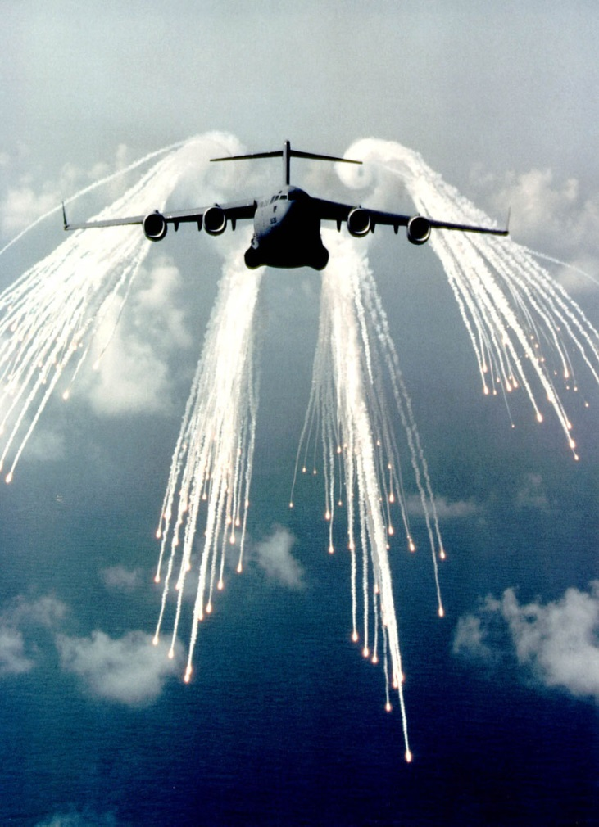
Return Home
Stress and Change Management
*Ups and Downs of the Holiday Season -During the holiday, expectations about the “way it should be” and reality often collide. This seminar explores how to cope with the pressures of the holiday season, and offers strategies to reduce stress. Please contact the Mental Health Clinic @ 623-856-7579 to schedule briefing.
*Life in Balance: Relaxation and Stress Relief- Objectives for this presentation include maintaining a good work/life balance, identifying stressors, recognizing the signs and symptoms of stress, practicing stress management strategies, reducing overall stress, and developing relaxation skills. Please contact the Mental Health Clinic @ 623-856-7579 to schedule briefing.
Return To Workshop Menu

Slide 5
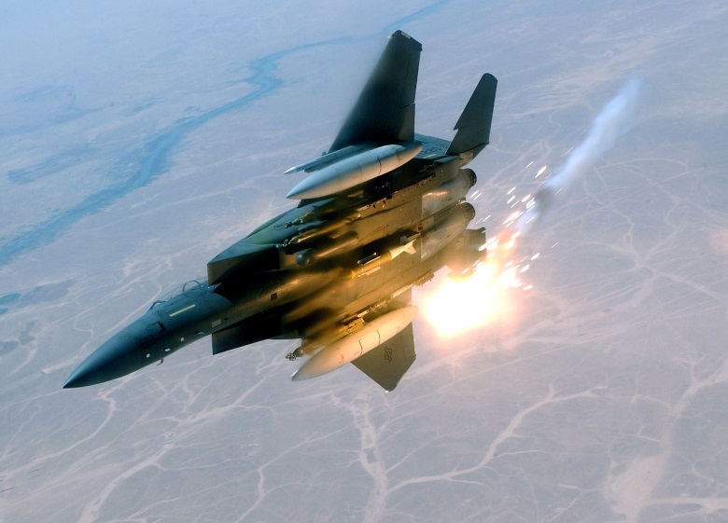
Return Home
Anger Management
*Anger Happens- Anger can lead to behaviors we regret, and it can also affect our health. This presentation focuses on understanding what happens to us when anger is triggered, and ways to address our strong reactions. Please contact Family Advocacy to schedule this briefing @ 623-856-3417.
*Anger Management- This presentation is geared towards adults who need help managing anger. Topics include defining anger, identifying one's "anger style," increasing self control through personal awareness, practicing techniques to manage one's own anger, and adopting new strategies to calm other angry people. Please contact the Military Family Life Counselor at 623-856-0565 to schedule briefing.
Return To Workshop Menu

Slide 6
Return Home
Mental Health Services
*Depression: What It Is and How to Help -The primary focus of this seminar is to educate participants about the warning signs and dangers of depression, and how it can be treated. Please call the Mental Health at 623-856-7579 to schedule briefing.
*Stress and Trauma Exposure: Strategies for Coping-Those individuals who work with victims and survivors of traumatic events may experience strong reactions as a result of hearing about or helping those who’ve been affected by trauma. This presentation is designed to offer information about strategies to prevent and manage the effects of “secondary trauma.” Please call the Mental Health at 623-856-7579 to schedule briefing.
*Domestic Violence: Effects on the Workplace. Domestic violence affects the individual employee, and has an impact on the workplace as well. This presentation identifies those potential effects, and suggests approaches that colleagues and agencies can take to address the issue. Please contact Family Advocacy to schedule this briefing @ 623-856-3417.
*Dynamics of Addiction -Addiction is a topic that is often associated with substance abuse, but many behaviors can also become addictive, including shopping, working, and computer use, to name a few. This presentation looks at a range of addictive behaviors, the differences between a habit and an addiction, and the steps in changing behavior. Please call ADAPT at 623-856-7579 to schedule briefing.
Return To Workshop Menu

Slide 7
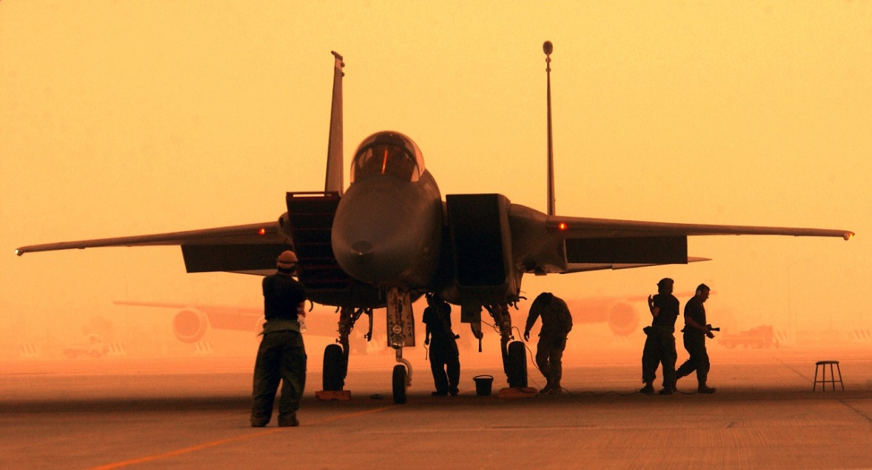
Return Home
Grief
*Surivor’s Guilt- The goal of this presentation is to teach people how to comfort the bereaved. Topics include the stages of grief, physical and emotional reactions to grief, the characteristics and effects of survivor's guilt, tips for helping grieving people, and special considerations for when the bereaved is a long distance away. Please contact the Military Family Life Counselor at 623-856-0565 to schedule briefing.
*Supporting the Bereaved at Home and Down Range- Objectives for this presentation include understanding the symptoms and effects of survivor's guilt, developing coping strategies, and utilizing tips for helping children and adolescents recover. Please contact the Military Family Life Counselor at 623-856-0565 to schedule briefing.
Return To Workshop Menu

Slide 8
Return Home
Personal Relationships
*Relationship Strength: Know the Communication-Quick overview about communication techniques that will make or break a relationship. Gives pointers on how to recognize those styles that will sabotage intimacy. Please contact Family Advocacy to schedule this briefing @ 623-856-3417.
*How Not to Fall For a Jerk(ette)-Highlights the characteristics of what not to look for in a partner and focuses on two tools that will allow for healthy relationship development. Please contact Family Advocacy to schedule this briefing @ 623-856-3417.
*Building a Healthy Marriage- Participants in this presentation will learn to create and maintain a healthy marriage through the development of communication skills, conflict resolution strategies and personal boundaries. Please contact the Military Family Life Counselor at 623-853-0565 to schedule briefing.
*Mission Based Marriages- This presentation is driven by the idea that a marriage should be focused on a specific vision of the future. Objectives include defining the beliefs and values that give meaning and direction to marriage, understanding what the family does and where it's going, knowing the steps required to achieving goals for the family, utilizing strategies for strengthening and protecting the marriage, and practicing effective problem-solving techniques as a couple. Please contact the Military Family Life Counselor at 623-853-0565 to schedule briefing.
*Healthy Relationship Skills for Singles- This presentation teaches single people how to prepare for a relationship. Objectives include clarifying one's expectations and priorities in a relationship, choosing the right person to enter a relationship with, understanding the right reasons for entering a long-term relationship, and practicing strategies for choosing and developing a healthy relationship. Please contact the Military Family Life Counselor at 623-856-0565 to schedule briefing.
*Matri-Money: Money and Marriage: The purpose of this presentation is to address financial concerns that may present challenges to married couples. Objectives include exploring emotional connections to financial matters, utilizing goal setting strategies, and practicing effective communication. Please contact the Military Family Life Counselor at 623-856-0565to schedule briefing.
*Recovering from Divorce: Topics covered in this presentation include the definition of divorce, the stages of grief/loss, possible physical and emotional reactions to divorce, coping strategies, tips for discussing a divorce with outside parties, techniques for discussing divorce with children, and recommendations for navigating divorce in a healthy way. Please contact the Military Family Life Counselor at 623-856-0565 to schedule briefing.
Return To Workshop Menu

Slide 9
Return Home
Workplace Relationships
*Relationship Strength: Know the Communication-Quick overview about communication techniques that will make or break a relationship. Gives pointers on how to recognize those styles that will sabotage intimacy. Please contact Family Advocacy to schedule this briefing @ 623-856-3417.
*FOUR LENSES-designed to learn about your unique temperament and the temperaments of others. This assessment will also help you understand others in your organization. There is a cost associated to conduct this workshop due to the cost of the books, which the units requesting the training would need to purchase. This training would need to be requested and prearranged at least 30 days prior to workshop. Please contact the Airman and Family Readiness Center to schedule this workshop by phone 623-856-6550.
*Three Cs of Communication- This presentation seeks to help participants improve verbal and nonverbal communication through the use of the "Three C's" (communication, collaboration, and commitment). Please contact the Military Family Life Counselor at 623-856-6550 to schedule briefing.
*Communication Training- This presentation focuses on providing participants with communication strategies and guidelines. Topics include the components of communication, verbal and nonverbal communication, the characteristics of an active listener, tips for communicating over long distances, typical roadblocks to effective communication, and the importance of being assertive. Please contact the Military Family Life Counselor at 623-856-6550 to schedule briefing.
Return To Workshop Menu

Slide 10
Return Home
Family Support and Parenting
*A Humorous Look at Parenting-Focuses on challenges and triggers that will cause parents to lose their cool while offering ways to remain in control. Provides tips for practical skills that can be used immediately for more effective parenting. Please contact Family Advocacy to schedule this briefing @ 623-856-3417.
*Robotic Shaken Baby Syndrome Prevention: How to Handle the Inconsolable Crying-Shaken Baby Syndrome education is provided through a demonstration with a mechanized doll that fully displays the impact of this 100% preventable form of child abuse. This program is geared to make all caregivers of infants aware of the dangers and impact of shaking a baby and just how easy it is to cross the threshold of harm. Please contact Family Advocacy to schedule this briefing @ 623-856-3417.
*Effective Discipline for Children (ages 2-5, 6-9, 10-12, and 13-18)- The purpose of this presentation is to help parents discipline children effectively. Topics include recognizing the characteristics of child development, maintaining good communication, practicing effective methods of discipline, establishing rules and consequences, dealing with aggressive behavior, working with other caregivers, taking care of oneself in order to better care for one's children, and knowing when to seek help. Please contact the Military Family Life Counselor at 623-238-0565 to schedule briefing.
Return To Workshop Menu

Slide 11
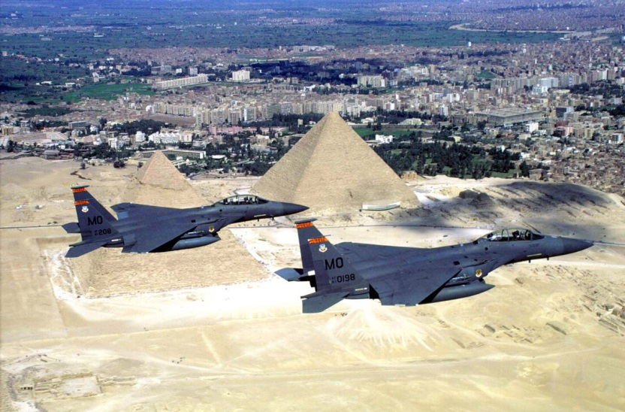
Return Home
Family Support and Parenting
*From Couplehood to Parenthood- This presentation aims to prepare parents for the transition into parenthood. Topics include ways parents can expect their lives to change after the arrival of a child, possible causes of conflict between new parents, techniques for avoiding conflict before it escalates, tips for making a smooth transition, and strategies for dealing with the deployment of a new father. Please contact the Military Family Life Counselor at 623-238-0565 to schedule briefing.
*K-12 Education/Exceptional Family Member Program (EFMP)-Workshops can be given on a variety of issues such as:
Common Core
Military Child Interstate Compact
Test Taking Information
IEP/504
Respite Care
Please contact the EFMP Coordinator at 623-856-7296 to schedule any EFMP or education related briefings.
Return To Workshop Menu

Slide 12
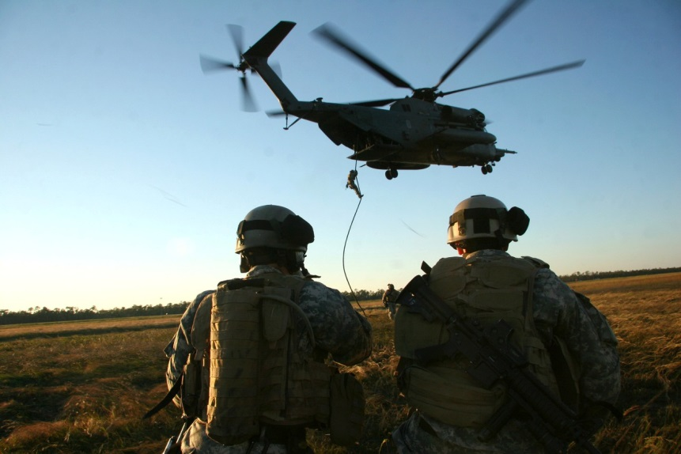
Return Home
Military Support
(deployment, relocation, separation, etc.)
*Smooth Move 101 -Offers tips on ensuring a successful PCS: Please contact the Airman and Family Readiness Center to schedule this workshop by phone 623-856-6550
*TRANSITION ASSISTANCE 101- This briefing is designed to inform service members and family members of the requirements and resources available to them during their transition from active duty, guard, or reserve. (note: All separating service members should begin the transition assistance program one year prior to date of separation. All retiring service members should begin the process two years prior to date of retirement.). Please contact the Airman and Family Readiness Center to schedule this workshop by phone 623-856-6550
*Challenges Faced by Dual Military Couples- When both halves of a couple are in the military, the relationship will have to weather many difficult situations. This presentation highlights the positive aspects of being a dual military couple, the challenges that the couple may face, and the various ways in which they can cope with those challenges. Please contact the Military Family Life Counselor at 623-238-0565 to schedule briefing.
Return To Workshop Menu

Slide 13
Return Home
Military Support
(deployment, relocation, separation, etc.)
*Workshops for Military Parents-The Child and Youth Military Family Life Counselor (MFLC) is available to offer many presentations specific to assisting children of military members. Please contact the Child and Youth MFLC to schedule any family/parenting workshops by phone 623-238-0565.
Topics include:
A Children’s Guide to Coping with Disasters
A Guide to Helping Children Manager Anger
Building Resiliency in Children
Challenges of Changing Schools
Children and Moving
Children and Separation Issues of Deployment
Helping Children Deal with Deployment
Welcome Home: Reconnecting with Your Child After Deployment
Communication for Teens
Conflict Resolution
Dealing with Peer Pressure
Stress Management
Sibling/Parent Relationships: Building Healthy Relations
Teen Dating
Return To Workshop Menu

Slide 14
Return Home
Military Support
(deployment, relocation, separation, etc.)
*Workshops for Military Members and their Spouses-The Adult Military Family Life Counselor (MFLC) is available to assist with a variety of workshops addressing unique challenges faced by military members and their families. Please contact the Adult MFLC at 623-238-0565 to schedule any of these briefings (please note these briefings can be conducted on the weekends and after hours and can be included in pre and post deployment family events).
Combat Related Stress Reactions
Post Combat Risk-Taking Behaviors
Coping with Challenges of Transitioning Home
From Combat to Home
Family Reunion-Deployment Reintegration
Maintaining a Healthy Marriage During Deployment
Making Marriage Work After Deployment
Reigniting the Passion After Deployment
The Military Spouse-Commander and Chief on the Home Front
Parenting Skills for the Single Service Member
Pre-deployment and the Single Service Member
Coping with Challenges While on R & R
Coping with Transitions
Deployment Survival
Reintegration
Issues Family Face When the Military Member Deploys
Return To Workshop Menu

Slide 15
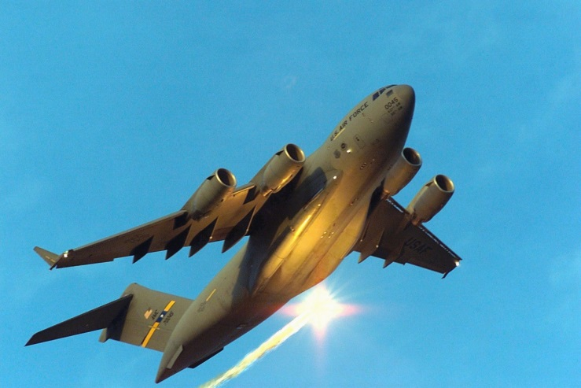
Return Home
Employment and Finances
*Employment assistance Workshops-Are designed for transitioning service members, civilians, and family members. The workshops will supply participants with a tool box to assist them with job hunting skills, resume writing techniques, and interview skills. The workshops can be tailored towards the audience. Workshops are available in the following areas:
Writing a Winning Resume
Tips on Writing a Federal Resume
Interview with Confidents
Please contact the Airman and Family Readiness Center to schedule this workshop by phone 623-856-6550.
*PERSONAL FINANCIAL MANAGEMENT- Offers information, education and counseling to help individuals reach and maintain financial stability and realize financial goals. Workshops are available in the following areas:
Money & Credit Management Class
Budget Analysis
Home Buyer’s Seminar
Savings and Investing
Please contact the Airman and Family Readiness Center to schedule this workshop by phone 623-856-6550.
Return To Workshop Menu

Slide 16
Return Home
Sexual Assault Prevention and Response (SARC)
*Unit tailored briefings can be delivered to address current concerns or trends. Training can include sexual assault prevention measures, available reporting options, and overview of support resources. Contact the installation SAPR Office at 623-856-4878 to schedule briefing.
Return To Workshop Menu

Slide 17
Return Home
Resiliency Skill Sets
*Air Force resilience training- is designed to sustain a thriving resilient Air Force Community that fosters mental, physical, social, and spiritual fitness. Air Force resilience training modules can be delivered by your unit Resilience Training Assistant (RTA). You can also request unit/audience tailored resilience training to be delivered by an installation Master Resilience Trainer. See below for current list of Resilience Skill sets and goal of each lesson. For a current list of RTAs or to arrange for a guest Master Resilience Trainer and unit tailored training please contact the Community Support Coordinator at 623-856-2716.
*Counting Blessings-The goal of Counting Blessings is to build positive thinking, help you cope with the daily hassles and stress, and improve quality of life.
*ABC-The goal of ABC is to examine how your thoughts contributed to your Reactions. ABC can help assess if you thoughts were helpful in the particular situation and can help you think about how to approach future similar situations.
*Balance Your Thinking-Sometimes our thoughts can bias our viewpoint, leading to patterns of reactions that are unproductive. Balance Your Thinking allows you to examine the evidence and determine if you are missing critical information.
*Check Your Playbook-The goal of Check your Playbook is to discover patterns in your thoughts or reactions that might interfere with your goals or productivity.
*Good Listening and Active Constructive Responding-The goal of Active Constructive Responding is to express involvement, excitement, or enthusiasm about another person’s positive event. The goal of Good Listening is to make someone feel safe in speaking to you as a confidante.
*Interpersonal Problem Solving-The goal of Interpersonal Problem Solving is to help confront problems in manner that still shows respect for the relationship. It lowers the intensity and makes it easier for two people to find a resolution to the problem or come to an understanding or compromise they can each live with.
Return To Workshop Menu

Slide 18
Return Home
Resiliency Skill Sets
*Accomplishing Goals-Accomplishing Goals gives us a sense of purpose and a feeling of control over our lives.
*Acceptance-The goal of Acceptance is to acknowledge that sometimes there are negative aspects of events you can’t control. Rather than avoiding, acknowledge the discomfort so you focus on taking action.
*Spiritual Resilience-The goal of Spiritual Resilience is to promote an understanding of spiritual resilience and provide an opportunity for students to strengthen their spiritual fitness.
*Physical Foundation: Fuel for Resilience-Our physical well-being is strongly linked to our resilience and emotional well-being. The Physical Foundation of Resilience focuses on healthy nutrition and sleep management to ensure optimal performance.
For additional information, check out http://wingmantoolkit.org
Return To Workshop Menu

